Slide 1

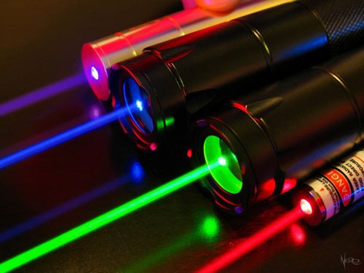
lasers
Presented by:
KAUTIK BHARDWAJ MRADUL AGRAWAL
]
MBA Tech.
SANSKRITI SHARMA
1st Year [Team MAGNUS]
MAYANK PERWANI

Slide 2
CONTENTS-
INTRODUCTION TYPES OF LASERS
SEMI-CONDUCTOR LASER APPLICATIONS OF SEMI-CONDUCTOR LASERS
ADVANTAGES OF SEMI-CONDUCTOR LASERS

Slide 3
LASER- Introduction
“Laser” is an acronym for Light Amplification by Stimulated Emission of Radiation.
A laser is a device that emits light through a process of optical amplification based on the stimulated emission of
electromagnetic radiation.

Slide 4
TYPES OF LASERS
RUBY LASER
Nd-YAG LASER
He-Ne LASER
CO2 LASER
SEMI- CONDUCTOR LASER

Slide 5
SEMI-CONDUCTOR LASER
In this presentation we will emphasize of on the SEMI-CONDUCTOR LASER.
Semiconductor lasers are solid-state lasers based on semiconductor gain media, where optical amplification is usually achieved by stimulated emission at an interband transition under conditions of a high carrier density in the conduction band.

Slide 6
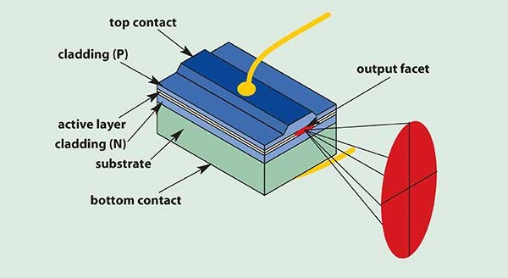

Slide 7



APPLICATIONS OF SEMI-CONDUCTOR LASERS
Laser have been used for measuring distances , so they are very useful for surveying and ranging.
Lasers are suitable for communication and they have significant advantages because they are more nearly monochromatic.
Laser lights are highly intense and used for welding, cutting of materials, machining and drilling holes.

Slide 8
Lasers are used in eye surgery , treatment of dental decay and skin decay.
Lasers are used in Barcode scanners in markets and supermarket.
Lasers are used in printers.
Lasers are used in Photodiode detection.

Slide 9



ADVANTAGES OF SEMI-CONDUCTOR LASERS
Semi-conductor lasers are easy in operating. Long life
Highly monochromatic and continuous beam. excellent efficiency.
DISADVANTAGES OF SEMI-CONDUCTOR LASERS
It has got low power about 200 mW.

Slide 10
THANK YOU!

